Slide 1
Data 602 project
Chicago shooting data analysis
By Kalkidan Weldearegay
University of Maryland Baltimore County
Dec 06,2021
Fall 2021

Slide 2
Overview
In this analysis we are going to cover about the analysis on the Chicago data set.
The source of the dataset is Violence Reduction - Victims of Homicides and Non-Fatal Shootings Public from the Chicago Data portal
Source dataset link: https://data.cityofchicago.org/resource/gumc-mgzr.csv

Slide 3
GOALS
There are to main goals to this project:
1) Explore the relationships between certain variables such as AGE, RACE and WARD to the chance of being involved in a fatal and nonfatal shooting
2) Trying to predict those chances using different ML classification techniques
In this project I will predict the correlation with the age and the shooting involvement.

Slide 4
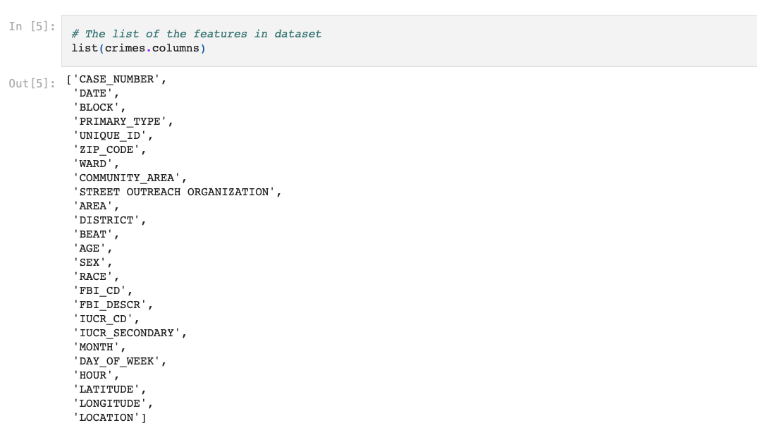
Lists of the columns in the datasets

Slide 5
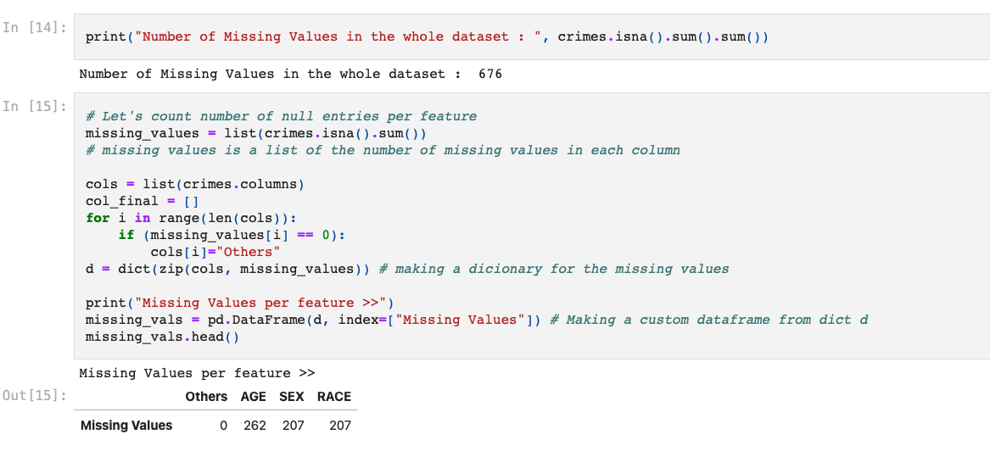
Checking if there is a missing values in the dataset

Slide 6
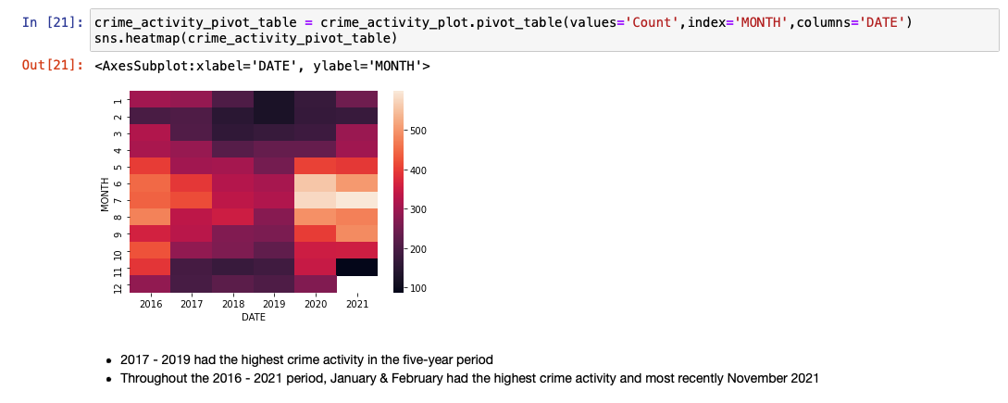
Correlation of the dataset
The months in 2020 with the highest crime activity are June & July.
Throughout the 5-year period, these months recorded the highest crime activity

Slide 7
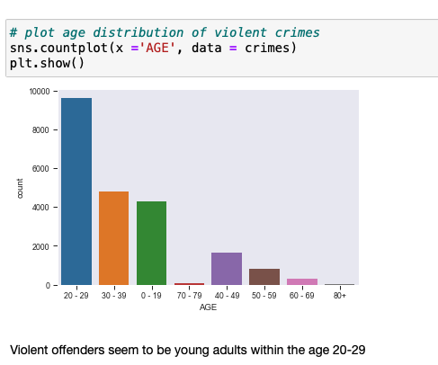
Age distributions of violent crimes
Violent offenders seem to be young adults within the age 20-29

Slide 8
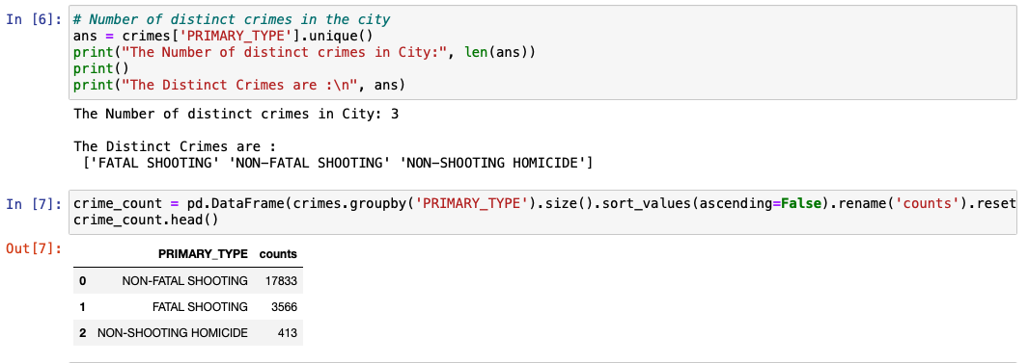
Eda information

Slide 9
Imbalanced data set
how to deal with the imbalanced data set I used Synthetic Minority Oversampling Technique to deal with class imbalance smote = SMOTE()
source:https://www.analyticsvidhya.com/blog/2020/07/10-techniques-to-deal-with-class-imbalance-in-machine-learning/
Which helped with the fitting the predictor and target variable
- x_smote, y_smote = smote.fit_resample(X, Y) and Stratifying target variable

Slide 10
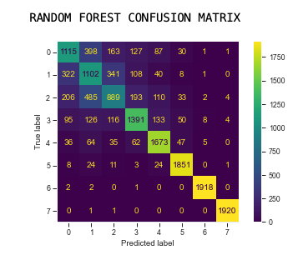
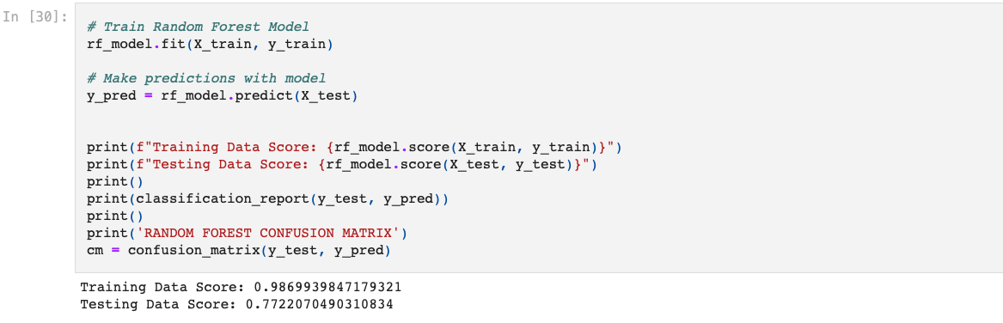
Machine learning models
Random forest model

Slide 11
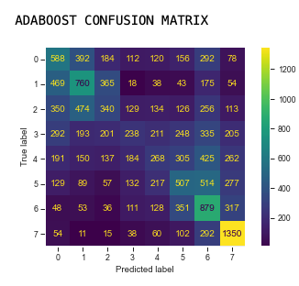
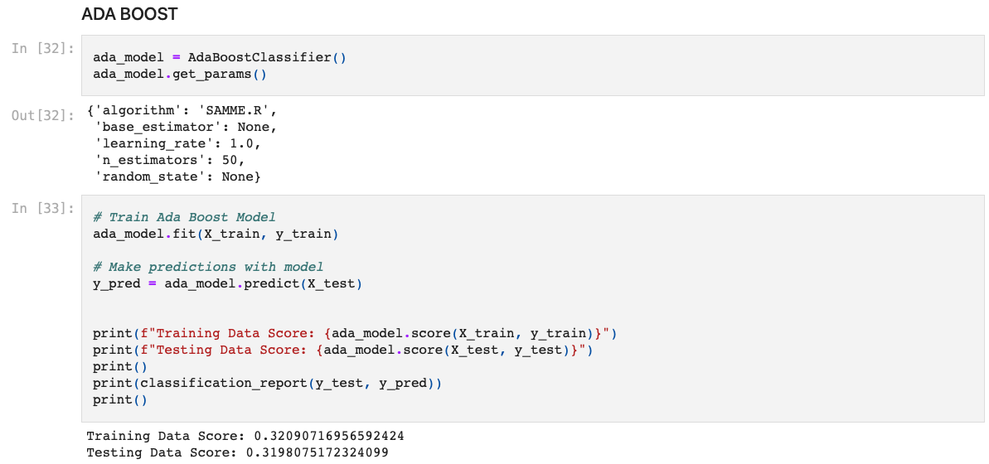
Machine learning models
ADA Boost

Slide 12
ML MODELS
Based on the analysis shown on the slides before, it shows that the random forest has a better result than ADA boost with both accuracy and precision

Slide 13
Reference
-The source of the dataset is Data is extracted from the Chicago Police Department's CLEAR (Citizen Law Enforcement Analysis and Reporting) system. Violence Reduction - Victims of Homicides and Non-Fatal Shootings Public from the Chicago Data portal
Source dataset link: https://data.cityofchicago.org/resource/gumc-mgzr.csv
To deal with the Imbalanced Data set Synthetic Minority Oversampling Technique was used. source:https://www.analyticsvidhya.com/blog/2020/07/10-techniques-to-deal-with-class-imbalance-in-machine-learning/

